Slide 1
Shoosh for Kids
Communication toolkit for sport organisations, clubs and associations

Slide 2
Purpose of this pack
The Shoosh for Kids campaign is a collaboration between the Office of Sport (OOS) and our sector partners to encourage positive spectator behaviour at junior sport.
The Office of Sport has developed a suite of digital resources for organisations, clubs and associations to access, use and share so as to amplify the Shoosh for Kids campaign.
The assets can be downloaded via the links supplied in this pack and logos added or adapted using your existing image editing software.
Assets include:
Newsletter, EDM and website banners
Social media tiles and posts
Email signatures
Posters.

Slide 3
Practical implementation
While growing the Shoosh For Kids partner network and building awareness of the campaign and messaging are important elements of this initiative, the Office of Sport wants to drive social and behavioural change starting at the grassroots level.
In addition to the promotional resources included in this toolkit, we have included some ideas on ways that the Shoosh For Kids messaging could be practically implemented by your SSO, association or club.
We have also highlighted a few successful programs and initiatives already put in place by organisations across Australia that we hope will inspire you to think about creating your own.
We have also provided a list of external resources at the end of this toolkit should you wish to learn more about this topic.

Slide 4
The Shoosh for Kids Message
Five Key Themes
Shoosh for Kids isn’t about staying completely silent, it’s just about making sure we’re all positive. Our messages across the campaign run across five key themes: Overarching: Think before you speak General participation: Keep it positive. Keep it fun. ​ Supporting the coaches: Let coaches do the coaching.​ Volunteer appreciation: Remember, volunteers run kids sport.​ Respecting the officials: Respect the referee

Slide 5
Social Content Week 1: w/c Monday 1 May
Keep it Positive, Keep it Fun. Think before you speak.
Click here to download the social tile.
Post: Support the kids at sport this weekend, just think before you speak. Keep it positive, keep it fun. #ShooshforKids

Slide 6
Keep it Positive. Keep it Fun. Think Before You Speak
Practical Implementation Ideas
Print and display Shoosh For Kids signage prominently around your venue. Place it in high traffic and creative areas (e.g. canteen lines, toilet stall doors, entry gates, BBQ area) Make regular ground announcements over your PA system with Shoosh For Kids messaging. Place an ad/page in your event programs/draws reminding spectators to remain positive and outlining unacceptable behaviours. Designate a Shoosh For Kids “Ambassador/s” volunteer to be present at your venue during competitions. Consider giving them a bright shirt or vest to make them visible to spectators. Allow them to speak to spectators about their behaviour and answer questions if required. Include a reminder about Shoosh For Kids month in emails, newsletters or text messages you send throughout May to your members.

Slide 7
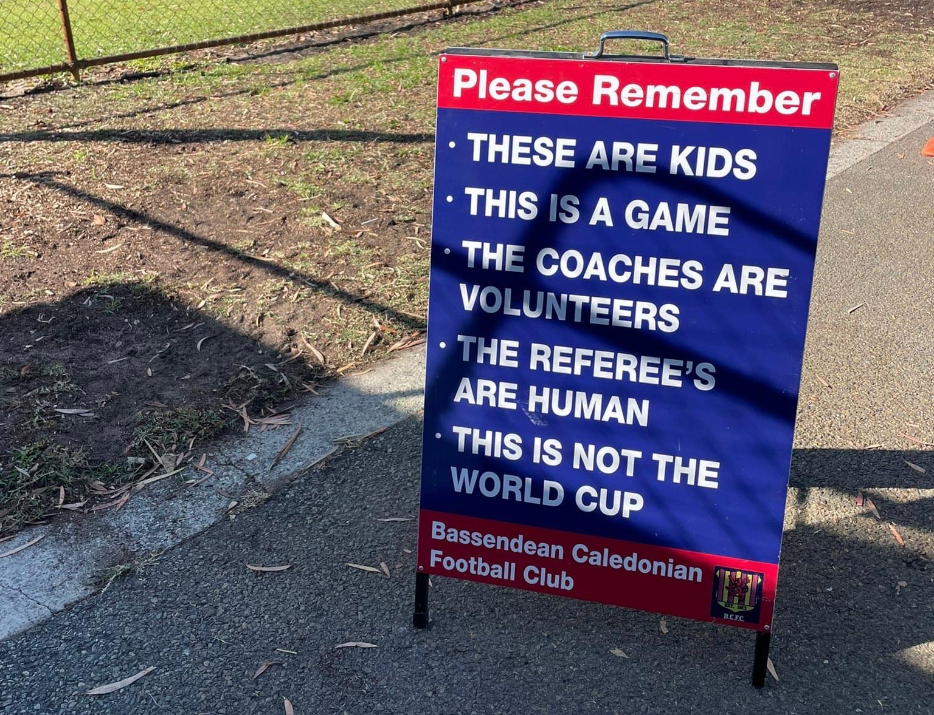
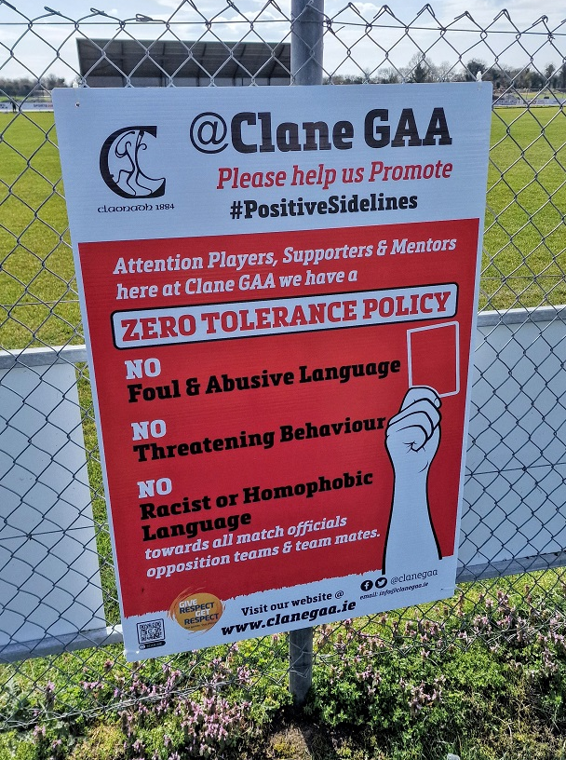
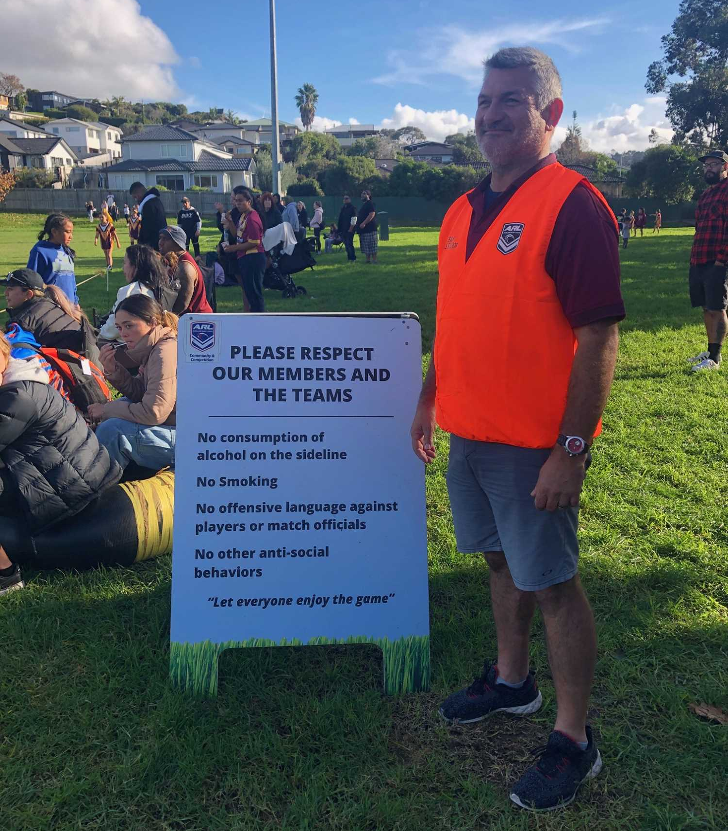
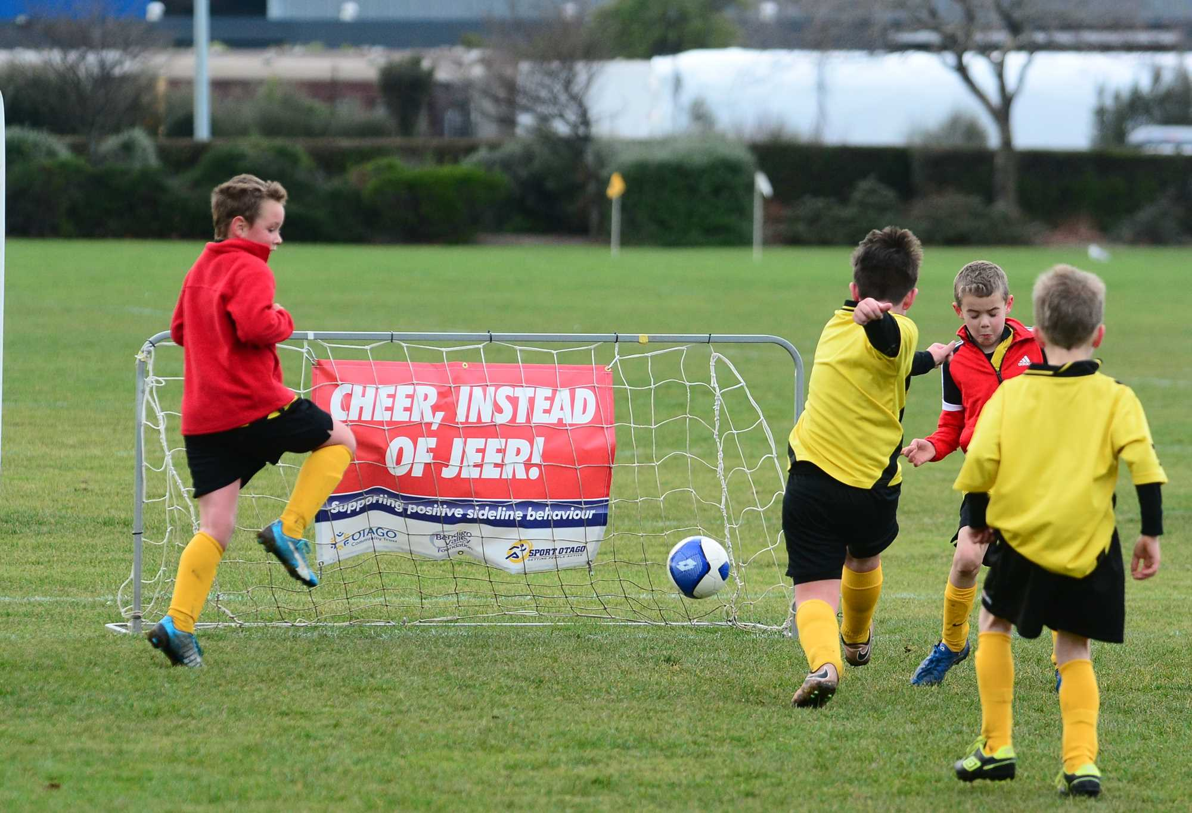
Example – Ground/Venue Signage
Keep it Positive, Keep it Fun. Think before you speak.
A great way to ensure that messaging about positive sideline behaviour is visible and front-of-mind for spectators at your venue is through signage at your field, track or court.
Many governing bodies, clubs and associations across Australia and the rest of the world have seen success in reducing poor spectator behaviour through the development of eye-catching and well-crafted signage at their grounds.
The Office of Sport has developed a range of basic Shoosh For Kids signage templates that clubs and associations can get printed through their local print suppliers. These include fence banners, poster, a-frame signs and teardrop banners.
Click here to access our signage templates.

Slide 8
Social Content Week 2: w/c Monday 8 May
Respect the Referee Think before you speak.
Click here to download the social tile.
Post: Referees are volunteers and make mistakes, just like you and me. Respect their decisions. Think before you speak. Keep it positive, keep it fun. #ShooshforKids

Slide 9
Respect The Referees. Think Before You Speak
Practical Implementation Ideas
Create a ‘Respect For Officials’ campaign and encourage your members and other clubs to take part. Develop signage, place messaging on uniforms, spread messaging through social media, newsletters, website etc. Encourage all athletes to shake the hands of officials before or after an event. Develop a ‘Coloured Shirt/Vest’ program to support and help spectators identify new and/or developing umpires and referees. Implement a warning card or penalty system for unruly spectators that introduces consequences (point deduction, free kick, removal from venue) for poor behaviour towards officials.

Slide 10
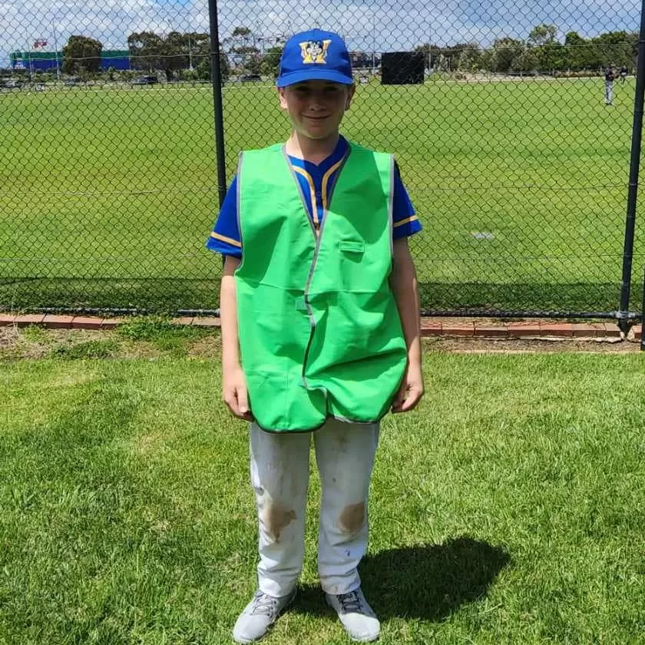
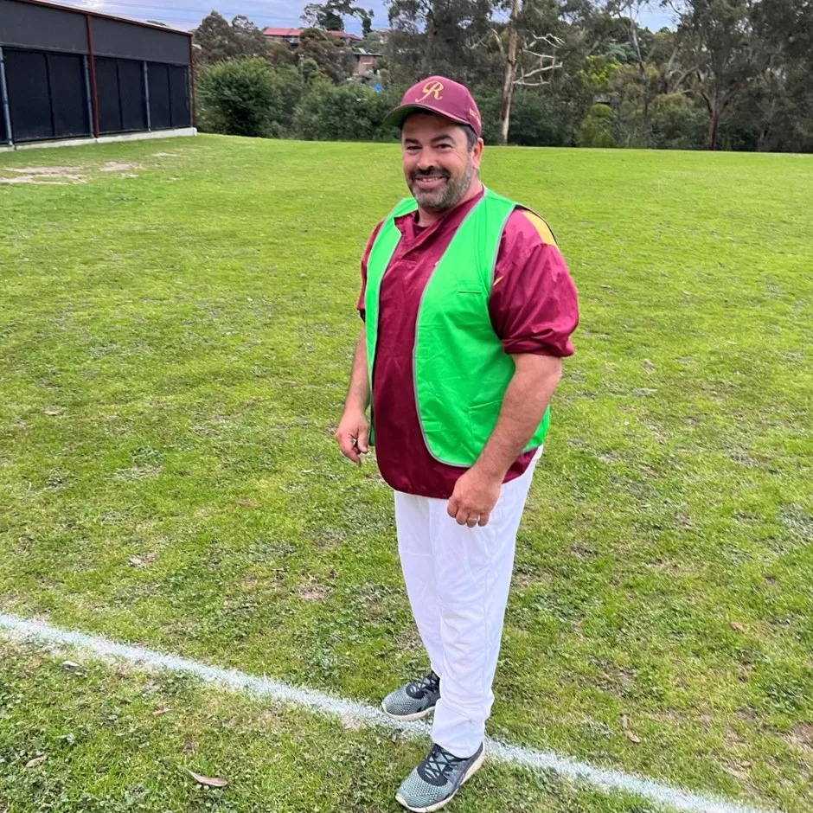
Example – ‘Coloured Shirt’ Program
Respect the Referee Think before you speak.
Across Australia, a number of SSO’s and sporting bodies including Baseball VIC, Netball SA, Athletics SA and Softball Australia have implemented a ‘Coloured Shirt/Vest’ program designed to help increase the number of officials in their sport, and support young officials moving through their ranks.
Beginner umpires are provided bright shirts or vests to wear to identify them as “in training” and are partnered with a more experienced or senior official as a mentor.
The main aims of the program include:
Make new or inexperienced officials easily recognisable to educate all participants including players and spectators.
To raise awareness/understanding and increase the recognition and support of new officials.
Assist in reducing pressure and lessening abuse and conflict directed towards new officials
The ‘Coloured Shirt’ programs have proven successful across the board in increasing umpire/referee numbers and in reducing instances of poor sideline behaviour.
MORE INFORMATION:
Baseball Victoria – Green Vest Program
Netball South Australia – Coloured Shirt Program
Softball Australia – Community Umpire Program
Athletics SA – Coloured Shirt Program

Slide 11
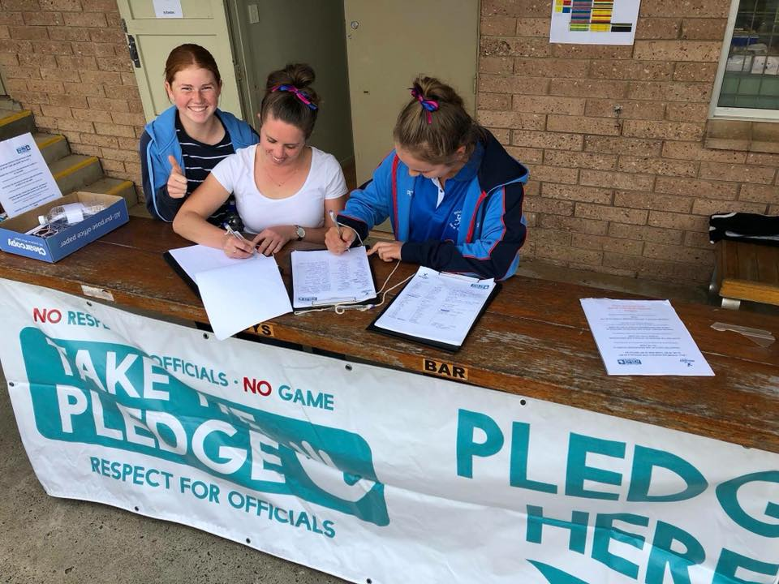
Example – Hockey NSW: Respect For Officials
Respect the Referee Think before you speak.
In 2018, Hockey NSW launched a campaign entitled “Respect For Officials” with the tagline No Respect. No Officials. No Game.
The main aim of the campaign was to encourage all of their members to sign and “Take The Pledge” either online or in person at their events, to champion respect for all officials through the actions they take while at games.
The Respect For Officials campaign also involved a number of other elements, including:
Ground signage and announcements
‘Ambassador’ umpires and officials
Uniform branding
Social media and digital promotion
The campaign was well received by their members and they received over 3000 pledges, along with positive media coverage of the initiative.
Respect For Officials was expanded when Hockey Australia and other state hockey bodies across the country joined in promoting the initiative. More Information – Hockey NSW: Respect For Officials

Slide 12
Social Content Week 3: w/c Monday 15 May
Remember volunteers run kids sport. Think before you speak.
Click here to download the social tile.
Post: The coaches, referees, administrators, canteen and first aid staff at junior sport are all mostly volunteers.
Remember this and appreciate their efforts.
Think before you speak. Keep it positive, keep it fun. #ShooshforKids

Slide 13
Remember - Volunteers Run Kids Sport. Think Before You Speak
Practical Implementation Ideas
Celebrate a ‘Volunteer Appreciation’ round during the season and promote the work that volunteers do at your SSO, club or association. Reward or incentivise volunteers where possible/appropriate to encourage involvement (discount rego fees, free uniform or equipment, canteen vouchers) Recognise volunteer efforts by highlighting key/star people. Introduce weekly or annual awards for volunteers who go above and beyond. Run awareness sessions for parents and spectators before or during the season to help highlight what sideline behaviours are acceptable or not.

Slide 14
Social Content Week 4: w/c Monday 22 May
Let coaches do the coaching. Think before you speak.
Click here to download the social tile.
Post: Support your coaches at junior sport this weekend. Encourage your kids to listen to their coach and follow their advice, even though you may think differently.
Think before you speak. Keep it positive, keep it fun. #ShooshforKids

Slide 15
Let Coaches Do The Coaching. Think Before You Speak
Practical Implementation Ideas
Have coaches complete training* or an awareness session on positive sideline behaviour. Develop a Code of Behaviour or Conduct for your club or association and ensure all members and coaches are provided or can access a copy. Consider incorporating material/resources on sideline behaviour into accreditation programs/courses. Develop a coaching mentor program where experienced coaches can help guide and advise new coaches on best practices and provide support where required.
* Play By The Rules/Sports Integrity Australia – Let Kids Be Kids Mini Course.

Slide 16
Access more digital assets
Create your own campaign!
Access more digital assets including editable social tiles, editable posters, email signatures, EDM headers, website headers, logos and more.
Visit:
Shoosh for Kids resources | NSW Government

Slide 17
External Resources
Find out more about how sideline behaviour affects junior athletes and how to create a more positive environment at grassroots sports at the pages below:
https://www.playbytherules.net.au/
https://www.clearinghouseforsport.gov.au/
https://www.healthdirect.gov.au/developing-life-skills-through-sports
https://raisingchildren.net.au/teens/healthy-lifestyle/physical-activity/sport-positive-attitude

